Slide 1

Department of Computer Science and Engineering
Advanced Pest Identification: An Efficient Deep Learning Approach Using VGG Networks
PRESENTED BY
Divvela Chandu Venkateswara Guptha (21471A05E7)
Jujjuri Sai (21471A05F9)
Kandula Rajesh (21471A05G2)
Under the Guidance of,
K Lakshminadh _{MTech, PhD},
Professor,
Department of Computer Science and Engineering,
Narasaraopeta Engineering College (Autonomous),
Narasaraopet- 522 601.

Slide 2
OUTLINE
Abstract
Introduction
Literature Survey
Research Gaps
Problem Statement
Objectives
Block Diagram / Flow Diagram
Methodology
Implementation
Results and Analysis
Conclusion & Future Scope
References
Question and Answers
Acknowledgements

Slide 3
ABSTRACT
Accurate pest identification is crucial for both effective pest management and crop protection. Pests must be found early in order to minimize damage and guarantee crop security. Conventional techniques typically entail visual examination and professional involvement, which can be time-consuming and susceptible to human error. On the other hand, deep learning-powered high-performance systems can now more accurately identify pests thanks to developments in computer vision. In this work, we employed the Kera's-based deep learning models VGG16 and VGG19 to construct a passive pest detection system. We greatly improved the efficacy of these models in identifying pest species by using strategies such data augmentation, model optimization, and modification of validated models. The VGG16 model produced an amazing accuracy rate of 99.8% and VGG19 model produced an accuracy of 96.8 % in our testing.

Slide 4
INTRODUCTION
Pests pose a significant threat to agriculture, leading to substantial crop losses and impacting global food security.
Traditional pest identification methods often rely on visual inspections by experts, which are time-consuming and prone to human error.
This research aims to develop an automated pest detection system using deep learning techniques, employing VGG16 and VGG19 models with data augmentation and optimization to enhance accuracy and applicability in agricultural pest management.

Slide 5
LITERATURE SURVEY
No | Title | Author | Journal Name & Year | Methodology Adapted | Key Findings | Gaps
1 | Pest Identification Based on Fusion of Self-Attention With ResNet | Hassan et al. | IEEE Access, 2024 | Combined ResNet with self-attention for pest identification. | ResNet + Self-Attention: Achieved 99.80% accuracy. | High computational costs and diverse pest datasets.
2 | Based on FCN and DenseNet framework for the research of rice pest identification methods | Gong et al. | Agronomy, 2023 | FCN and DenseNet for feature extraction and classification. | FCN: Achieved 94.3% accuracy. DenseNet: Achieved 95.6% accuracy. | Scalability to multiple pest species is not addressed.
3 | Pest Identification and Counting of Yellow Plate in Field Based on Improved Mask R-CNN | Rong et al. | Discrete Dynamics in Nature and Society, 2022 | Improved Mask R-CNN for pest detection on yellow plate traps. | Mask R-CNN: Achieved 97.9% accuracy. | Limited to pests on yellow plates.
4 | Plant disease and insect pest identification based on vision transformer | Li et al | IoTML 2021, 2022 | Vision Transformers (ViT) for pest and disease detection. | Vision Transformer (ViT): Achieved 98.4% accuracy. | High computational and hinder practical deployment.
5 | JutePestDetect: An intelligent approach for jute pest identification using fine-tuned transfer learning | Talukder et al. | Smart Agricultural Technology, 2023 | Transfer learning on pre-trained models for jute pests.. | Transfer Learning: Achieved 96.2% accuracy. | Limited generalizability to other crops.

Slide 6
LITERATURE SURVEY
Recent research in pest identification has explored the application of deep learning techniques to improve the accuracy and efficiency of pest detection. S. M. Hassan and A. K. Maji proposed an approach combining self-attention mechanisms with ResNet architectures, achieving an impressive 99.80% accuracy with ResNet50-SA, surpassing other deep learning models in performance. Their study demonstrates the significant enhancement in feature extraction and focus on crucial features, enabled by self-attention, leading to better pest identification results. The performance of ResNet101-SA and ResNet152-SA also showed notable results, with accuracy rates of 88.48% and 96.68%, respectively. This highlights the potential of incorporating attention mechanisms for improved pest detection systems.

Slide 7
RESEARCH GAPS
High Computational Costs (Hassan et al., IEEE Access, 2024)
Gap Identified: The model used in this study required a lot of computing power, which makes it difficult to use in real-world applications.
Addressed the issue : Using simpler models like VGG16 and VGG19 to achieve high accuracy while using less computational resources, making it more practical to implement.
Scalability to Multiple Pest Types (Gong et al., Agronomy, 2023)
Gap Identified: The method in this paper was not tested for many pest types, so its use is limited.
Addressing the issue: Our model includes nine different pest types, making the model more useful for various agricultural needs.

Slide 8
PROBLEM STATEMENT
Traditional pest identification methods are time-consuming, error-prone, and require expert knowledge.
Accurate and timely pest detection is crucial for effective pest control and crop protection.
This research develops a deep learning-based solution using VGG networks to improve pest identification accuracy and efficiency.

Slide 9
OBJECTIVES
To develop a deep learning model using VGG network for pest identification.
To improve feature extraction, accuracy in pest detection using attention mechanisms.
To evaluate the model’s performance across different pest species and environments.
To optimize the model for real-time pest monitoring applications in agriculture.

Slide 10
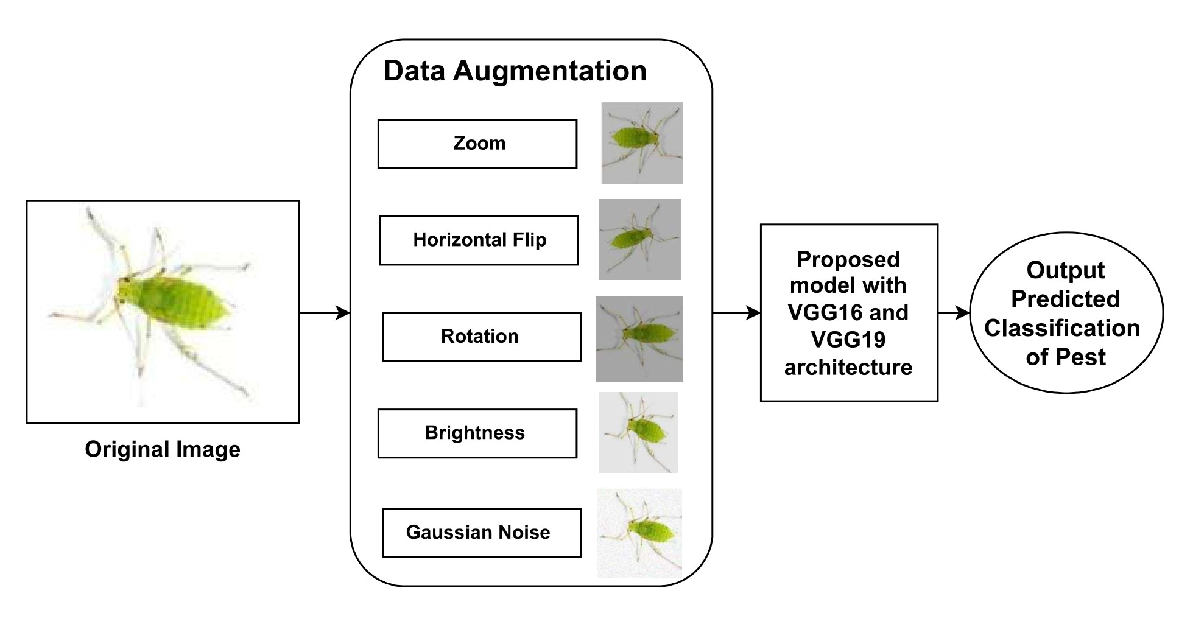
BLOCK DIAGRAM OR FLOW DIAGRAM

Slide 11
METHODOLOGY
Dataset Composition:
Data Augmentation techniques:
Various data preprocessing techniques are used to increase the size of the dataset such as,
Scientific Name | Pest Name | Original Image Count
Aphidoidea | Aphids | 350
Spodoptera frugiperda | Armyworm | 350
Coleoptera | Beetle | 350
Helicoverpa armigera | Bollworm | 350
Caelifera | Grasshopper | 350
Acariformes | Mites | 350
Culicidae | Mosquito | 350
Symphyta | Sawfly | 350
Scirpophaga incertulas | Stem borer | 350
Zoom
Rescale
Horizontal flip
Rotation
Brightness adjustment
Gaussian Noise
The dataset comprises 3,150 images of nine distinct crop pests: Aphids, army worms, boll worms, beetles, grasshoppers, mites, sawflies, mosquitoes and stem borers. To keep the image size consistent, every picture was resized to 224 x 224 pixels even if the original image had been of different size. Additional data augmentation techniques, such as rotation, flipping, and scaling, were applied to further enhance the dataset and improve model robustness.

Slide 12
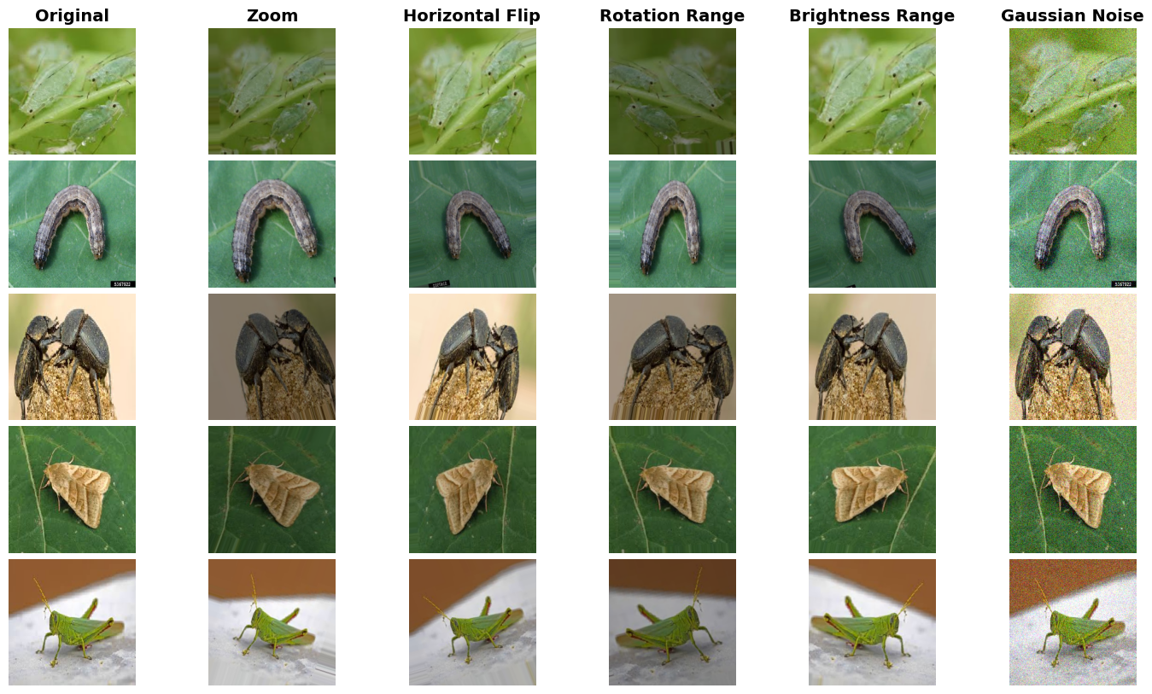
Augmented Images

Slide 13
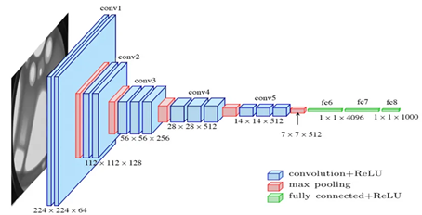
Deep Learning architectures
VGG Network: VGG stands for Visual Geometry Group; it is a standard deep Convolutional Neural Network (CNN) architecture with multiple layers.
VGG16 model: The VGG16 architecture contains the convolutional layers 13, fully connected layers 3 and 5 max-pool layers
VGG19 model: The VGG16 architecture contains the convolutional layers 16, fully connected layers 3 and 5 max-pool layers .

Slide 14
IMPLEMENTATION
Data Preprocessing: The dataset was augmented using ImageDataGenerator to include transformations like rotation, brightness adjustment, and horizontal flipping. Additional Gaussian noise was introduced to enhance model robustness and reduce overfitting. All images were resized to 224x224 pixels to align with the input requirements of VGG16.
Train-Test Data Split: Balanced split with augmented training data and rescaled testing data for accurate model evaluation.
Model Building: VGG16 and VGG19 used as a base with frozen convolutional layers and custom dense layers for pest classification.
Model Training: Trained with Adam optimizer (learning rate 0.0001) for 50 epochs, using a learning rate scheduler to address validation loss plateaus.
Evaluation Metrics: Performance assessed using accuracy, loss, confusion matrix, and classification metrics (precision, recall, F1-score).

Slide 15
LAYERED DETAILS OF VGG16 MODEL
LAYERED DETAILS OF VGG19 MODEL
Layer Name | Output Shape | Param #
input layer (Input Layer) | (224 × 224, 3) | 0
b1 convl1 (Conv2D) | (224 × 224, 64) | 1,792
b1 convl2 (Conv2D) |  | 36,928
b1 max pool (MaxPooling2D) | (112 × 112, 64) | 0
b2 convl1 (Conv2D) | (112 × 112, 128) | 73,856
b2 convl2 (Conv2D) |  | 147,584
b2 max pool (MaxPooling2D) | (56 × 56, 128) | 0
b3 convl1 (Conv2D) | (56 × 56, 256) | 295,168
b3 convl2 (Conv2D) |  | 590,080
b3 convl3 (Conv2D) |  | 590,080
b3 max pool (MaxPooling2D) | (28 × 28, 256) | 0
b4 convl1 (Conv2D) | (28 × 28, 512) | 1,180,160
b4 convl2 (Conv2D) |  | 2,359,808
b4 convl3 (Conv2D) |  | 2,359,808
b4 max pool (MaxPooling2D) | (14 × 14, 512) | 0
b5 convl1 (Conv2D) | (14 × 14, 512) | 2,359,808
b5 convl2 (Conv2D) |  | 2,359,808
b5 convl3 (Conv2D) |  | 2,359,808
b5 max pool (MaxPooling2D) | (7 × 7, 512) | 0
flatten layer | (25088) | 0
dense layer | (256) | 6,422,784
dropout layer | (256) | 0
dense 1 layer | (9) | 2,313
Layer Name | Output Shape | Param #
input layer (Input Layer) | (224 × 224, 3) | 0
b1 convl1 (Conv2D) | (224 × 224, 64) | 1,792
b1 convl2 (Conv2D) |  | 36,928
b1 max pool (MaxPooling2D) | (112 × 112, 64) | 0
b2 convl1 (Conv2D) | (112 × 112, 128) | 73,856
b2 convl2 (Conv2D) |  | 147,584
b2 max pool (MaxPooling2D) | (56 × 56, 128) | 0
b3 convl1 (Conv2D) | (56 × 56, 256) | 295,168
b3 convl2 (Conv2D) |  | 590,080
b3 convl3 (Conv2D) |  | 590,080
b3 convl4 (Conv2D) |  | 590,080
b3 max pool (MaxPooling2D) | (28 × 28, 256) | 0
b4 convl1 (Conv2D) | (28 × 28, 512) | 1,180,160
b4 convl2 (Conv2D) |  | 2,359,808
b4 convl3 (Conv2D) |  | 2,359,808
b4 convl4 (Conv2D) |  | 2,359,808
b4 max pool (MaxPooling2D) | (14 × 14, 512) | 0
b5 convl1 (Conv2D) | (14 × 14, 512) | 2,359,808
b5 convl2 (Conv2D) |  | 2,359,808
b5 convl3 (Conv2D) |  | 2,359,808
b5 convl4 (Conv2D) |  | 2,359,808
b5 max pool (MaxPooling2D) | (7 × 7, 512) | 0
flatten layer | (25088) | 0
dense layer | (256) | 6,422,784
dropout layer | (256) | 0
dense 1 layer | (9) | 2,313

Slide 16
RESULTS & ANALYSIS
Key Results: The VGG16 model achieved an accuracy of 99.78% in pest classification within 4050 seconds, surpassing other models in both efficiency and performance, highlighting its suitability for real-world agricultural applications.
Models | Precision | F1-Score | Recall
VGG16 | 1.00 | 1.00 | 1.00
VGG19 | 0.97 | 0.97 | 0.97
ResNet50 (Self-Attention) | 1.00 | 1.00 | 1.00
ResNet101 (Self-Attention) | 0.98 | 0.98 | 0.98
ResNet152 (Self-Attention) | 0.97 | 0.97 | 0.97
MobileNet | 0.96 | 0.96 | 0.96
MobileNetV2 | 0.97 | 0.97 | 0.97
Model | Accuracy | Execution Time (GPU)
VGG16 (Proposed approach) | 99.78% | 4013 Seconds
VGG19 | 96.89% | 4451 seconds
ResNet50 (Self-Attention) | 99.78% | 5650 seconds
ResNet101 (Self-Attention) | 97.75% | 4830 seconds
ResNet152 (Self-Attention) | 96.67% | 6806 seconds
MobileNet | 96.70% | 5125 seconds
MobileNetV2 | 97.33% | 5445 seconds
Classification report of VGG16 in pest identification
Comparison of classification reports of different models

Slide 17
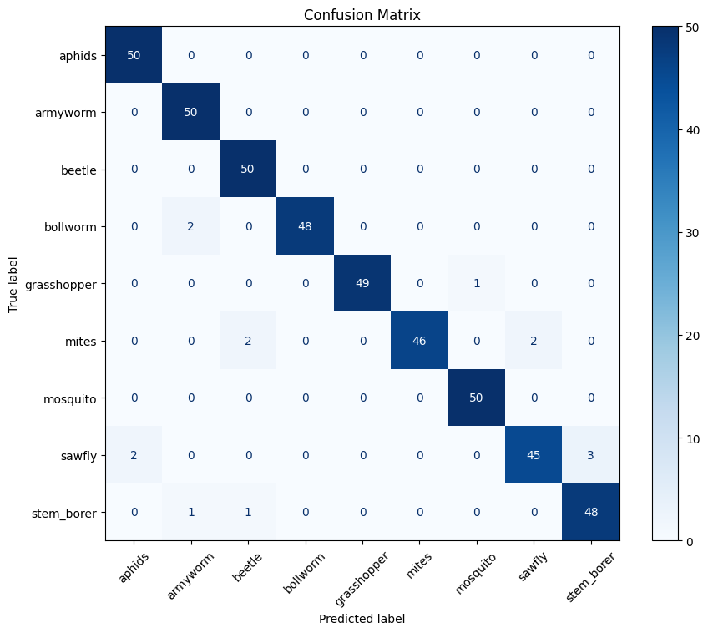
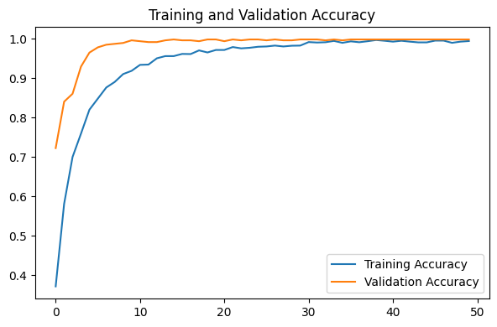
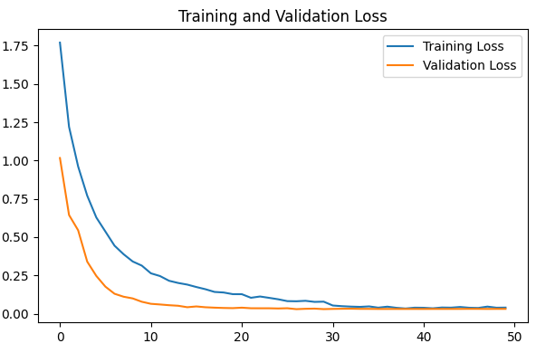
VGG16 Confusion matrix
Performance results of VGG16

Slide 18
CONCLUSION and FUTURE SCOPE
This research brings out the potential of deep learning to enhance Pest Identification and recommendation on Agriculture. Using VGG16 and VGG19 approaches, we designed a sensitive detection program that provided attentiveness assessments of 99.78% and 96.67%. To provide more data into the dataset which consists of 3150 images of nine different pest species, we have incorporated data augmentation strategies which also assisted in the minimization of over-fitting. Such results recommend that the proposed system can be useful for pest identification in real-life agriculture contexts. It is further possible to build on this work and consider real-time pest identification of a more diverse range of species, thus making it an even more useful tool for sustainable agriculture practices.

Slide 19
REFERENCES
[1] Spadaro, D., Agustí, N., Ortega, S.F., Hurtado Ruiz, M.A. (2020). Diagnostics and Identification of Diseases, Insects and Mites. In: Gullino, M., Albajes, R., Nicot, P. (eds) Integrated Pest and Disease Management in Greenhouse Crops. Plant Pathology in the 21st Century, vol 9. Springer, Cham. https://doi.org/10.1007/978-3-030-22304-5 8
[2] W. Xu, L. Sun, C. Zhen, B. Liu, Z. Yang, and W. Yang, ”Deep learning-based image recognition of agricultural pests,” Applied Sciences, vol. 12, no. 24, p. 12896, 2022. [Online]. Available: https://doi.org/10.3390/app122412896
[3] Cheng, X., Zhang, Y., Chen, Y., Wu, Y. and Yue, Y., 2017. Pest identification via deep residual learning in complex background. Computers and Electronics in Agriculture, 141, pp.351-356.

Slide 20
[4] Gong, H., Liu, T., Luo, T., Guo, J., Feng, R., Li, J., Ma, X., Mu, Y., Hu, T., Sun, Y. and Li, S., 2023. Based on FCN and DenseNet framework for the research of rice pest identification methods. Agronomy, 13(2), p.410.
[5] Yang, J., Ma, S., Li, Y. and Zhang, Z., 2022. Efficient data-driven crop pest identification based on edge distance-entropy for sustainable agriculture. Sustainability, 14(13), p.7825.
[6] Li, H., Li, S., Yu, J., Han, Y. and Dong, A., 2022, April. Plant disease and insect pest identification based on vision transformer. In International conference on internet of things and machine learning (IoTML 2021) (Vol. 12174, pp. 194-201).
[7] Rong, M., Wang, Z., Ban, B. and Guo, X., 2022. Pest Identification and Counting of Yellow Plate in Field Based on Improved Mask R-CNN. Discrete Dynamics in Nature and Society, 2022(1), p.1913577

Slide 21
[8] Talukder, M.S.H., Chowdhury, M.R., Sourav, M.S.U., Al Rakin, A., Shuvo, S.A., Sulaiman, R.B., Nipun, M.S., Islam, M., Islam, M.R., Islam, M.A. and Haque, Z., 2023. JutePestDetect: An intelligent approach for jute pest identification using fine-tuned transfer learning. Smart Agricultural Technology, 5, p.100279.
[9] Singh, K.U., Kumar, A., Raja, L., Kumar, V., Singh kushwaha, A.K., Vashney, N. and Chhetri, M., 2022. An Artificial Neural Network-Based Pest Identification and Control in Smart Agriculture Using Wireless Sensor Networks. Journal of Food Quality, 2022(1), p.5801206.
[10] Hu, K., Liu, Y., Nie, J., Zheng, X., Zhang, W., Liu, Y. and Xie, T., 2023. Rice pest identification based on multi-scale double-branch GANResNet. Frontiers in Plant Science, 14, p.1167121.

Slide 22
[11] Pest Dataset. Available: Sep. 15, 2023. Available: https://www.kaggle.com/datasets/simranvolunesia/pest-dataset
[12] M.Sireesha, S. N. TirumalaRao, Srikanth Vemuru, Optimized Feature Extraction and Hybrid Classification Model for Heart Disease and Breast Cancer Prediction International Journal of Recent Technology and Engineering Vol - 7, No 6, Mar - 2019 ISSN - 2277-3878, Pages – 1754 – 1772
[13] Simonyan, Karen & Zisserman, Andrew. (2014). Very Deep Convolutional Networks for Large-Scale Image Recognition. arXiv 1409.1556.
[14] S. L. Jagannadham, K. L. Nadh and M. Sireesha, ”Brain Tumour Detection Using CNN,” 2021 Fifth International Conference on I-SMAC (IoT in Social, Mobile, Analytics and Cloud) (I-SMAC), Palladam, India, 2021, pp. 734-739, doi: 10.1109/I-SMAC52330.2021.9640875

Slide 23
[15] Mascarenhas, S. and Agarwal, M., 2021, November. A comparison between VGG16, VGG19 and ResNet50 architecture frameworks for Image Classification. In 2021 International conference on disruptive technologies for multi-disciplinary research and applications (CENTCON) (Vol. 1, pp. 96-99). IEEE.
[16] Sunayna, S.S., Rao, S.N.T., Sireesha, M. (2022). Performance Evaluation of Machine Learning Algorithms to Predict Breast Cancer. In: Nayak, J., Behera, H., Naik, B., Vimal, S., Pelusi, D. (eds) Computational Intelligence in Data Mining. Smart Innovation, Systems and Technologies, vol 281. Springer, Singapore. https://doi.org/10.1007/978-981-16-9447-9 25
[17] S. M. Hassan and A. K. Maji, ”Pest Identification Based on Fusion of Self-Attention With ResNet,” in IEEE Access, vol. 12, pp. 6036- 6050, 2024, doi: 10.1109/ACCESS.2024.3351003.

Slide 24
QUESTIONS and ANSWERS
Open the floor for questions from the audience

Slide 25
ACKNOWLEGEMENTS
Express gratitude for the opportunity to present
Provide contact information for further inquiries

